Slide 1

Inferring the interplay between network structure and market effects in bitcoin
New journal of physics 16 (2014)
DáNiel kondor, istván csabai, jános szüle, márton pósfai & gábor vattay
BY: Sanjif rajaratnam
Notes:
The paper that I will be presenting today is “Inferring the Interplay Between Network Structure and Market Effects in Bitcoin”. This paper was published in the New Journal of Physics in 2014 and it was wrote by Daniel Kondor, Istvan Csabai, Janos Szule, Marton Posfai, and Gabor Vattay.

Slide 2


Presentation overview
1.0 Paper Overview
2.0 Bitcoin Background Information
3.0 Methodology
4.0 Data Mining
5.0 Extracting the core network
6.0 Detecting Structural Changes
6.1 Daily Snapshots: Weighted Adjacency Matrix
6.2 Principal Component Analysis (PCA)
7.0 Key Results
8.0 Relation to MIE1512H Research Project
9.0 References

Slide 3
1.0 Paper Overview
Research Question
“Aim to identify relevant changes in network structure over time and to uncover the relation of network structure and macroeconomic indicators of the system”
Data
Bitcoin’s Transaction Network
Procedure
Unsupervised identification of important features in the variation of the network over time
Analytical Method
Principal Component Analysis (PCA)
Notes:
The main research question this paper attempts to solve is “aim to identify relevant changes in network structure over time and to uncover the relation of network structure and macroeconomic indicators of the system”. Their main data source is Bitcoin’s public transaction network. They used principal component analysis to identify important features in the variation of the network over time.

Slide 4

2.0 bitcoin background information
Digital currency
Decentralized
No central governing authority
Finite Currency
Bitcoins are produced via “mining”
Mining rewards half every 210,000 blocks
Anonymous users
Bitcoin accounts are anonymous ‘addresses’
Users can have multiple addresses to protect their identity
Transparent
General ledger in the form of a Blockchain available to all users
Everyone knows how much Bitcoins belong to one address
Notes:
Bitcoin is a form of cryptocurrency that is created and held electronically. It is decentralized as no one controls it. Every machine that mines Bitcoin make up the network so no one person has power over the network. This currency isn’t printed and is produced by people and computers around the world solving mathematical problems. Bitcoin is a finite currency. There are only a finite number of Bitcoins available, 21 million to be exact, so people can’t produce more Bitcoins to de-value the currency. Bitcoins are produced via “mining” using computational power in a distributed network. “Miners” are rewarded for the “mining” blocks. The reward however halves every 210,000 blocks. About 77% of the total blocks have been mined and the current reward is 12 Bitcoins per block. This network of “miners” also process transactions made with Bitcoin, making it a standalone payment network. Bitcoin stores details of every single transaction that ever happened on the network in a general ledger in the form of a blockchain. Everyone knows how much bitcoins are stored at a given address. Users can use multiple addresses to protect their identity.

Slide 5
3.0 Methodology
Using the Bitcoin transaction network,
Find the core network of the system
Construct daily snapshots of transactions for the core network
Combined the daily snapshots into a matrix
PCA to identify key features in the evolution of the network over time
Analyze the results
Notes:
This is a general overview of the main methodology that was employed in this paper. To do their analysis, they first extracted the core from the Bitcoin network over two years. Then they constructed daily snapshots of transactions for the core network. Next, they concatenated all the snapshots into a matrix where each row corresponded to a day’s transactions and each column corresponding to a transaction. Finally, for analysis, they used Principal Component Analysis to identify the key features in the evolution of the network over time. Finally, they analyzed the base-network decay, the time-varying contribution of each base network, and the correlation between the network and the exchange rate.

Slide 6
4.0 Data mining
Source: Bitcoind
Bitcoin Daemon
Command-line interface for Bitcoin
Data:
Entire list of transactions for 2012/2013 on March 3, 2014
Schema:
Sending addresses
Receiving addresses
Value sent
Time of transaction
Notes:
The data for this paper was acquired from a slightly modified version of the open-source bitcoind client. They collected the entire list of transactions for 2012 and 2013 on March 3, 2014. The schema of their data was sending address, the receiving address, the value sent, and the time of transaction.

Slide 7
5.0 Extracting the core network
Contraction of graph
Identify addresses belong to the same user using a simple heuristic method
Identify 2 active cores :
Long Term (LT) Core
>100 individual transactions
>60 days
All Users (AU) Core
2000 most active users
Exclusions
Users associated with the Satoshi gambling site
Notes:
Their goal here was the extract the subgraph of the most active users. They did this by first contracting the graph. They did this by first identifying all the transactions with multiple inputs and then they assumed that if multiple addresses were involved in the same transaction, they belonged to the same user. They justified this assumption because users needed an account’s private key to use an account in a transaction. They, then identified 2 active cores within this subgraph. The first active core was defined as the long-term core which consisted of users active in greater than individual transactions, and active greater that 60 consecutive days. The second active core was defined as the all-users core which consisted of the 2000 most active users. The users that were associated with the Satoshi gambling site were excluded because they were considered statistical outliers and not related to the normal operation of the Bitcoin network.

Slide 8
6.0 detecting structural changes
Goal:
Compare successive daily snapshots of the active core with PCA to extract import changes in the graph structure
Daily Snapshot:
A weighted adjacency graph, where the weight of a link is equal to the number of transactions that occurred between node u and v.
Technique:
PCA to determine significant basis vectors on a matrix of concatenated daily snapshots
Notes:
The main goal here was to extract important structural changes from the graph by comparing successive daily snapshots using Principal Component Analysis. Here, the daily snapshot is defined a weighted network where the weight of each link is equal to the number of transactions that occurred between node u and v. Finally, the used Principal Component Analysis to determine the significant basis vectors on a matrix of concatenated daily snapshots.

Slide 9
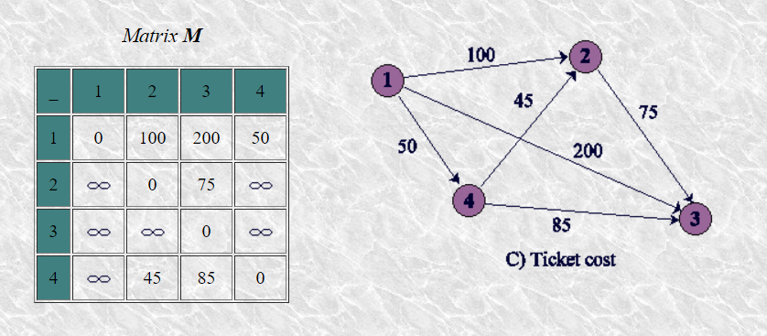
6.1 Daily Snapshot: Weighted adjacency matrix
Weighted adjacency graph
Weight: Number of transactions between users (nodes)
Rearrange each daily snapshot into vectors
Concatenate all daily snapshot vectors into a matrix
Notes:
For each day, a weighted adjacency matrix was constructed with all the nodes as columns and rows. The weight was equivalent to the number of transactions between the nodes. For example, user 1 had 100 transactions with user 2, 200 transactions with user 3, and 50 transactions with user 4. This weighted adjacency matrix was then rearranged into a long vector and then all the snapshot vectors were concatenated into a matrix.

Slide 10
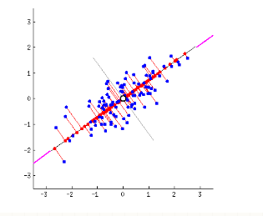
6.2 Principal component analysis (PCA)
Dimensionality Reduction Technique
Purpose: Choose new features in the form of basis vectors that can accurately explain the variance in the dataset
Goal: Maximize variance and minimize projection error
Notes:
They then analyze the constructed matrix using Principal Component Analysis. Principal Component Analysis is a dimensionality reduction technique that is currently implemented in Spark MLlib. The purpose of this technique is to extract the most important information from the given data set. This is done by finding new features that can accurately explain the variance in the data set. By doing so, we can compress the size of the data set by keeping only the important features. The first basis vector will explain as much variance as possible and each subsequent basis vector will explain as much of the variance left as possible. It explains the variance by creating new features that are linear combinations of the existing features. For example, in this data set, the basis vector will be along the center of these data points since variance is maximized in this direction. Here the new basis vector is linear combination of both x and y.
#The direction of the first principal component is given by the first eigenvector of the covariance matrix.

Slide 11
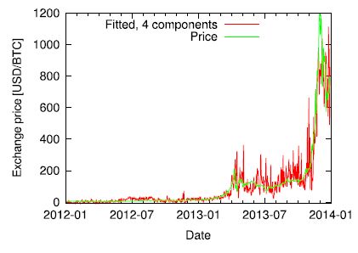
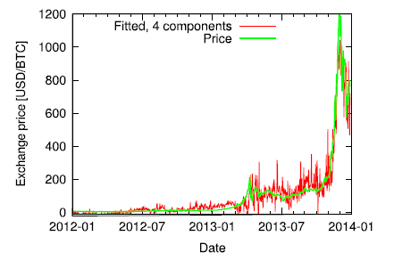
7.0 key Results
Network Covariance
Price Correlation
Notes:
The key result from their paper was they found a correspondence between the exchange rate time series and the LT core. To calculate the price, they first subtracted the average value of the price time series, and estimated this as a linear combination of singular vectors. They could approximate the exchange rate using both the first four base vectors ranked by variance explained, and the first four base vectors ranked by correlation to the price.

Slide 12

8.0 relation to mie1512H research project
Research Question
Find the import changes in the network structure over time and see if there is a relationship between the Ethereum network and it’s exchange rate
Data
Ethereum’s Network Structure
Procedure
Unsupervised identification of important features in the variation of the network over time
Analytical Method
Principal Component Analysis (PCA)
Notes:
The Ethereum network is like the Bitcoin network and has the same information in terms of transactions. The same research question can be answered but in terms of the Ethereum network. Daily snapshot vectors can be constructed and concatenated into a matrix. Then PCA can be performed to identify the key features of the network. Then the same method could be used to see if the network structure can be related the Ethereum exchange rate.

Slide 13
The end
Questions?

Slide 14
9.0 References
[1] Kondor, Daniel, et al. “Inferring the Interplay between Network Structure and Market Effects in Bitcoin.” New Journal of Physics, vol. 16, no. 12, Feb. 2014, p. 125003., doi:10.1088/1367-2630/16/12/125003
[2] http://www.bitcoinblockhalf.com/
[3] https://bitcoin.org/img/icons/opengraph.png
[4] http://www.coindesk.com/information/what-is-bitcoin/
[5] http://bitcoin.stackexchange.com/questions/tagged/bitcoind
[6] http://cpsc.ualr.edu/srini/DM/chapters/review5.3.html
[7] https://pdfs.semanticscholar.org/53b9/966a0333c9c9198cdf03efc073e991647c12.pdf
[8] http://stats.stackexchange.com/questions/2691/making-sense-of-principal-component-analysis-eigenvectors-eigenvalues
[9] https://www.ethereum.org/images/logos/ETHEREUM-LOGO_LANDSCAPE_Black.png
[10] https://en.wikipedia.org/wiki/File:UofT_Logo.svg

